Slide 1
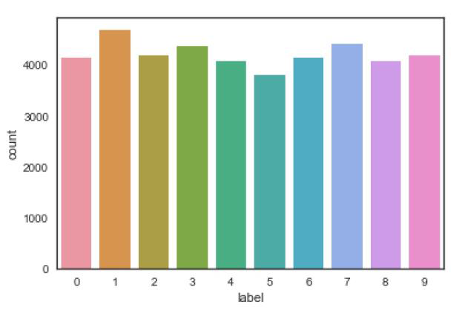
Optical Character Recognition using CNN- 1
Description:
This project is an Implementation of Optical Character Recognition using CNN using Keras. It is a 5 layers Sequential Convolutional Neural Network for digits recognition trained on MNIST dataset. I followed a tutorial from Yassine Ghouzam [1], this tutorial use keras API (Tensorflow backend) which is very intuitive. This solution is focus in two main sections first one prepare the data (handwritten digits images), second part was focus in train, use and evaluate the CNN model.
Results:
The achieved accuracy with this CNN trained in 1h10 on a single CPU (i7 2.5GHz) is 98.24% . In order to get better results, turn epochs to 30 to get 0.9967 accuracy, but this require a lot of time!
Data: Name: label, Length: 42000, dtype: int64
Reference
[1]https://www.kaggle.com/yassineghouzam/introduction-to-cnn-keras-0-997-top-6

Slide 2
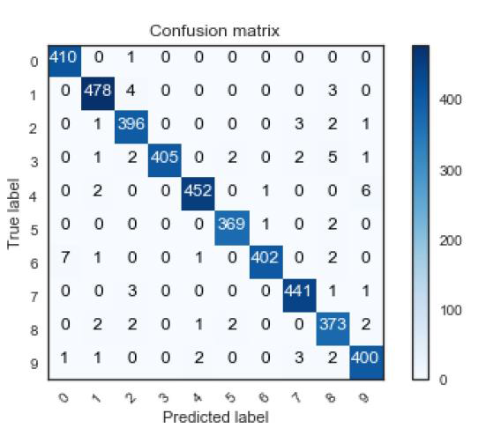
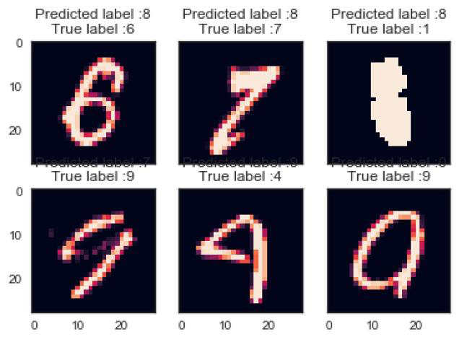
Optical Character Recognition using CNN- 2
Confusion matrix
Error Examples:
Reference
[1]https://www.kaggle.com/yassineghouzam/introduction-to-cnn-keras-0-997-top-6

